Slide 1
Setup and Installation
JDK 11

Slide 2
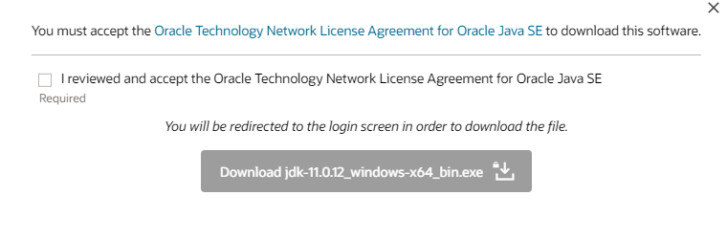
Installing JDK 11

Slide 3
Sign in to your Oracle Account

Slide 4
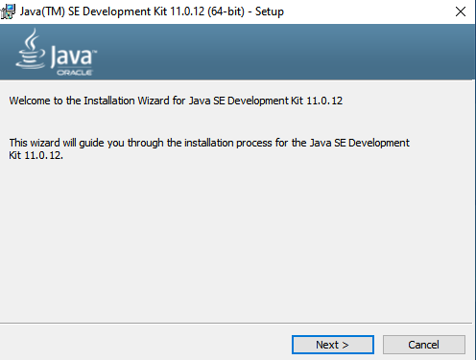
Download Installation File and Double Click it

Slide 5
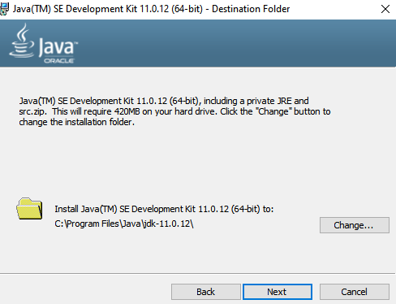
Choose installation folder

Slide 6
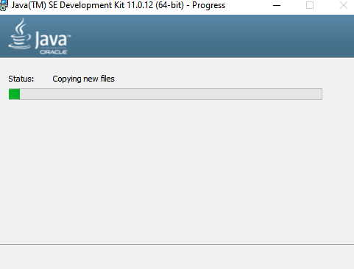
Wait for it to complete!

Slide 7
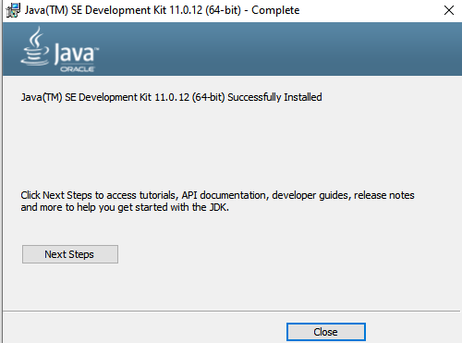
Success!!

Slide 8
Default Location of Java Installation Directory

Slide 9


Check installation at Command Prompt

